Slide 1
What Color are you?!

Slide 2
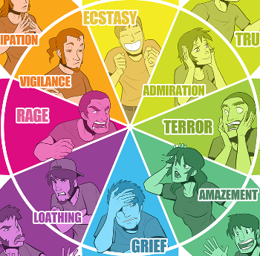
How do you feel when you look at colors?

Slide 3
Imagine a beautiful sunset. How does it make you feel?

Slide 4
Now let’s take the color away!
How have your feelings towards the sunset changed?
How does color help us? What can it give us?

Slide 5
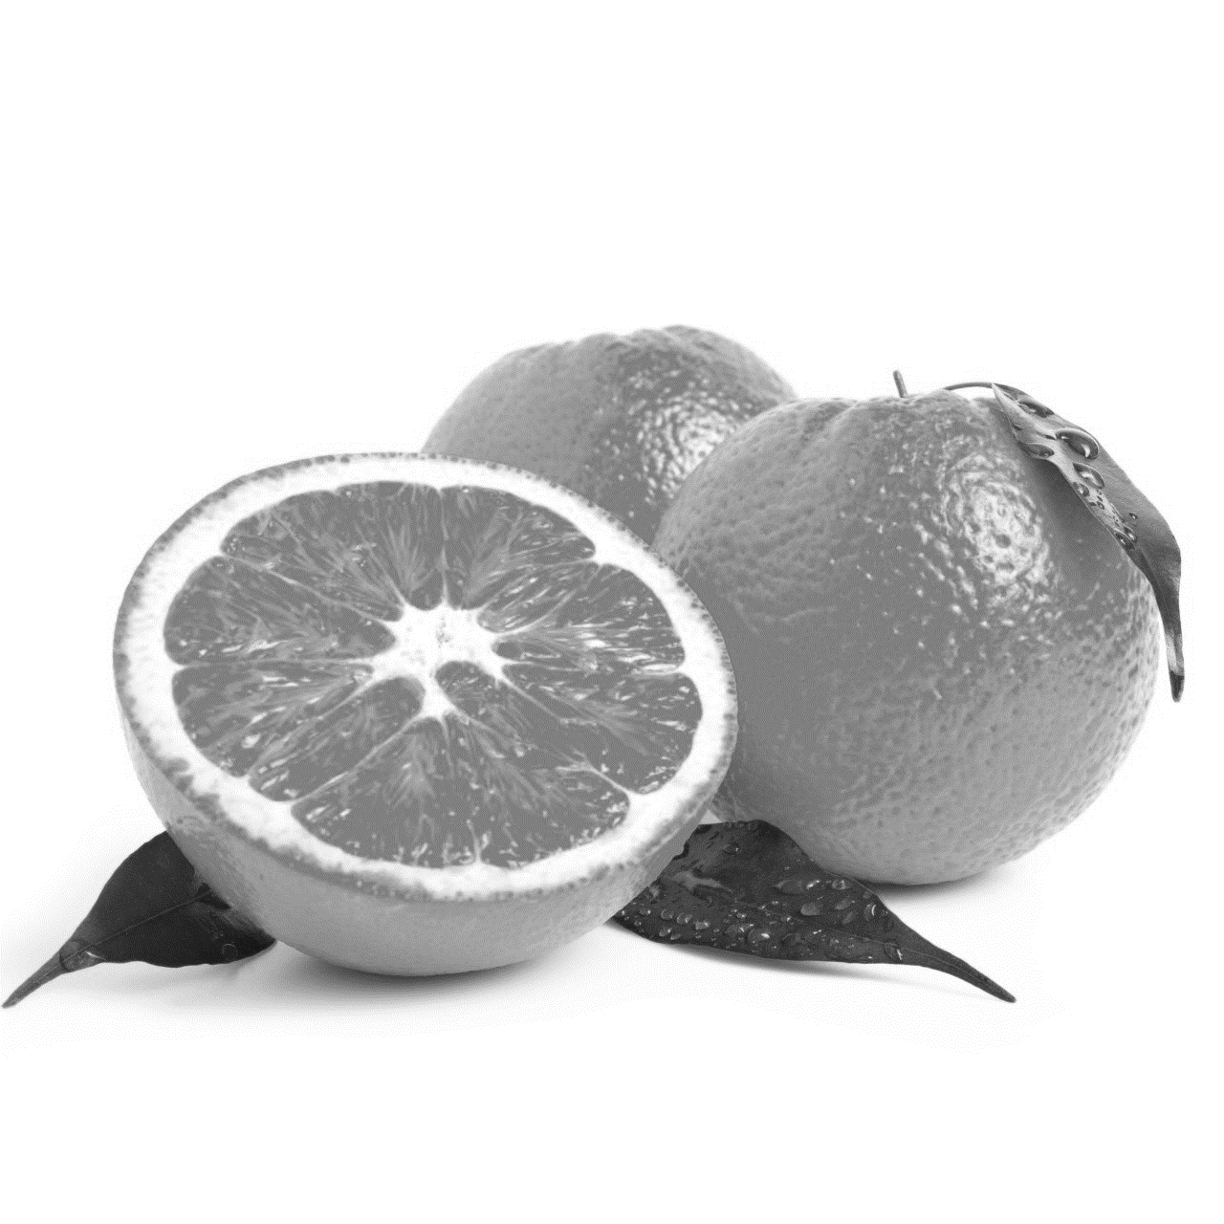
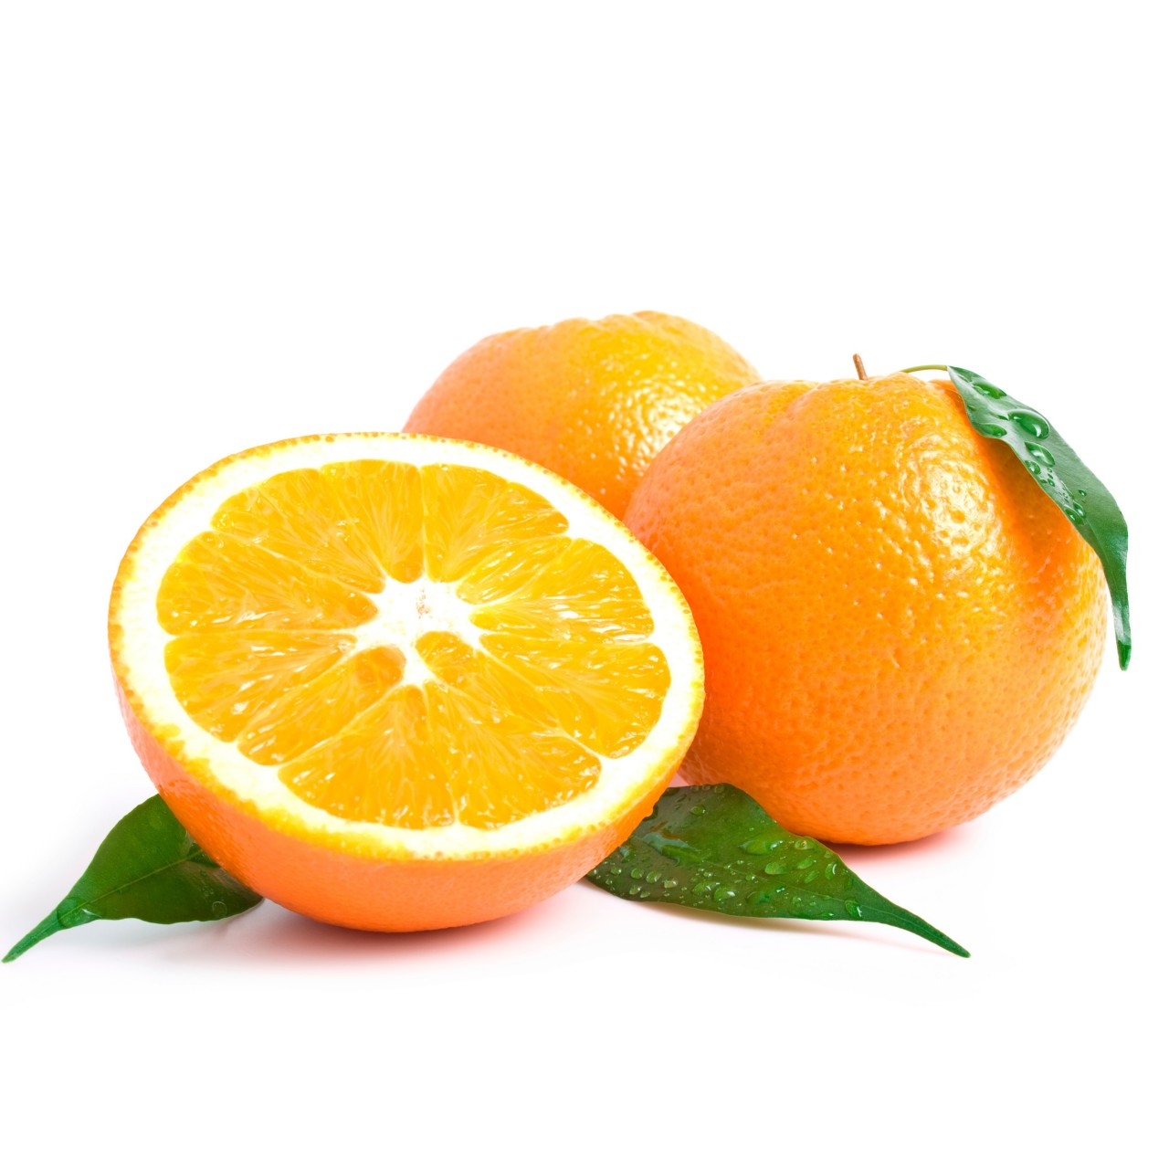
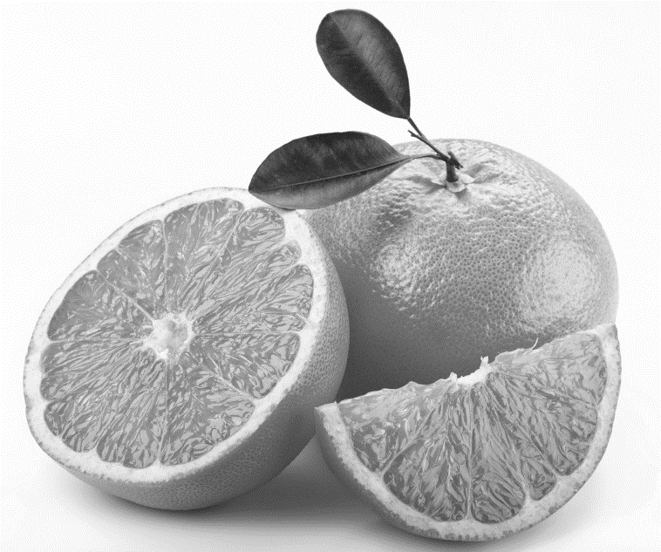
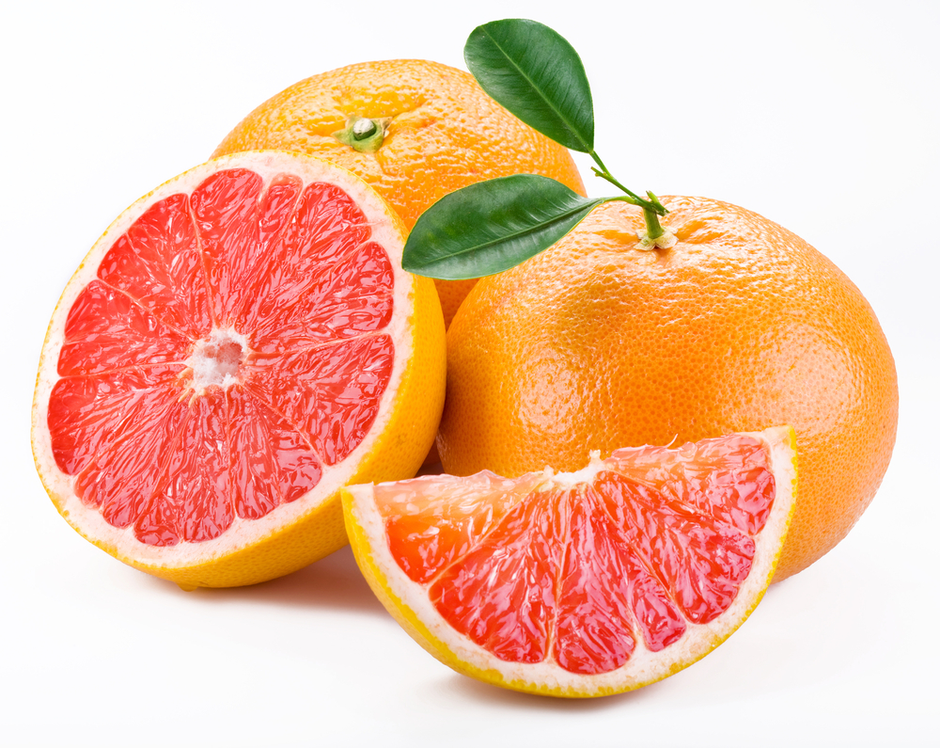
What type of fruit do you see?
Let’s add color!

Slide 6
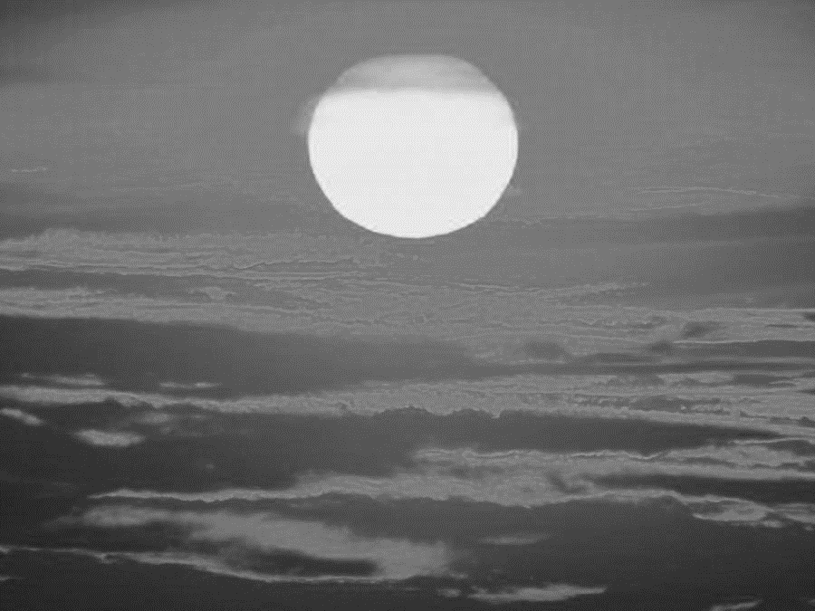
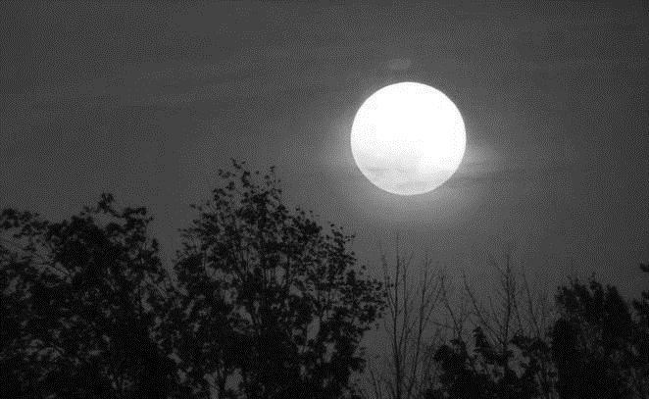
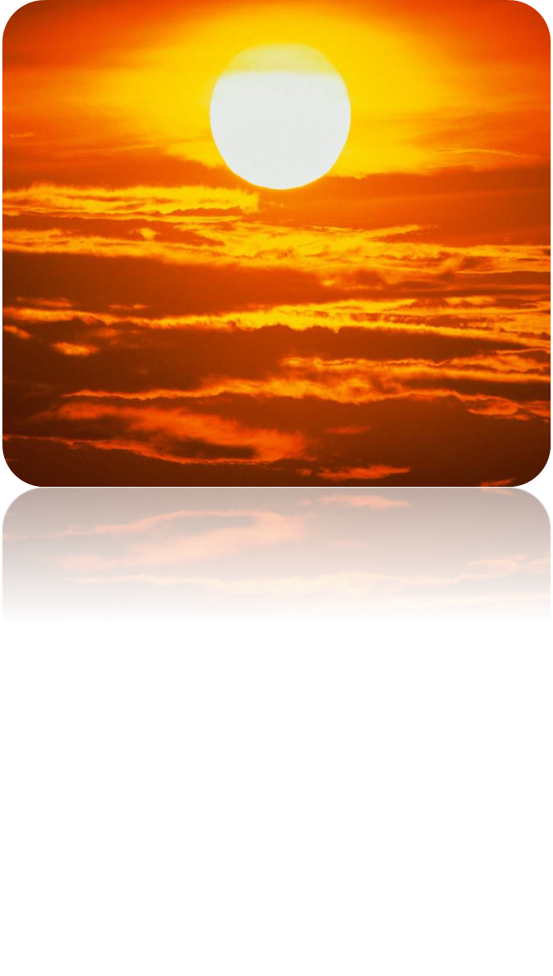
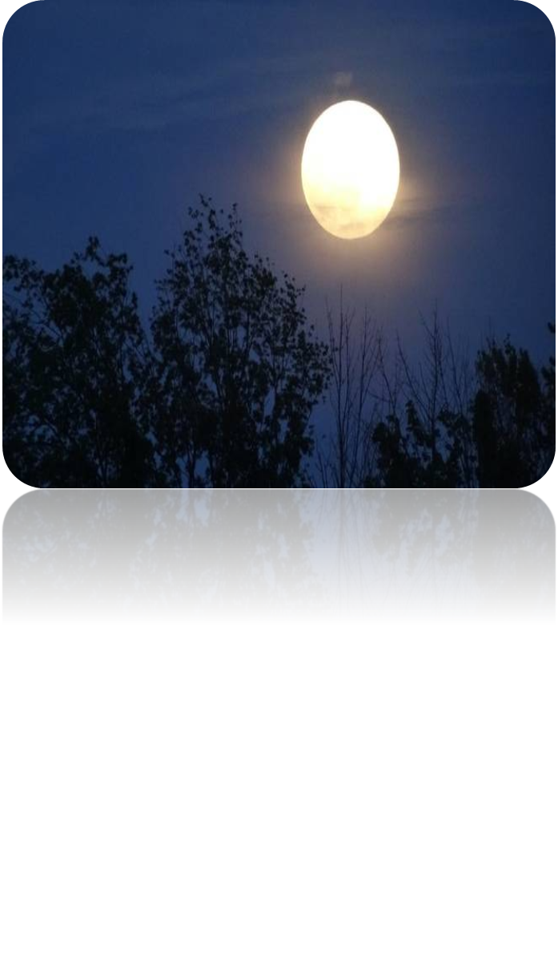
Why Color?
Color helps us to perceive, distinguish and recognize everything the world around us.

Slide 7
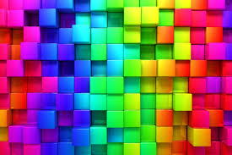
What is Color?
Color is the aspect of things that is caused by differing qualities of light being reflected or emitted by them.
To see color, you have to have light.
DID YOU KNOW?
Black is not a color! It is the absence of light.

Slide 8
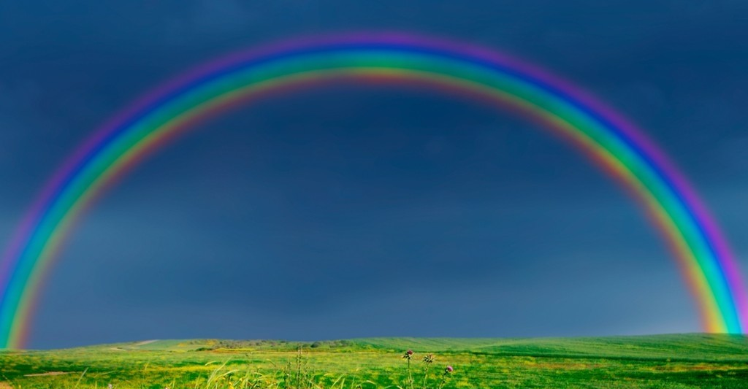
This is sequence of hues commonly described as making up a rainbow
A rainbow spans a continuous spectrum of colors; the distinct bands are an artifact of human color vision

Slide 9
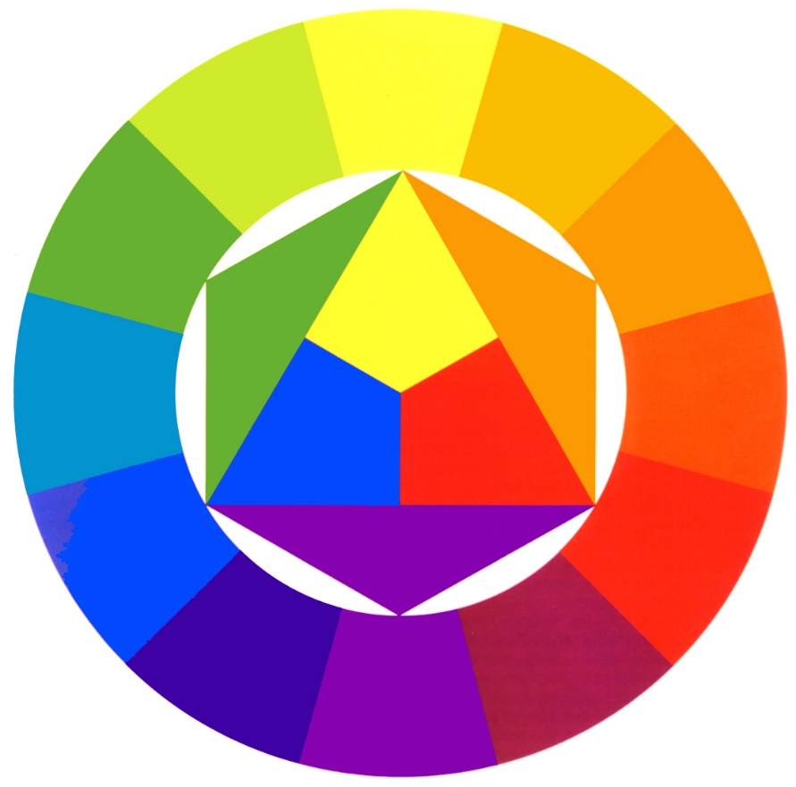
The Color Wheel
The color wheel shows relationships between the colors.
Artists often use the color wheel to help understand how colors relate to one another.
NEXT

Slide 10
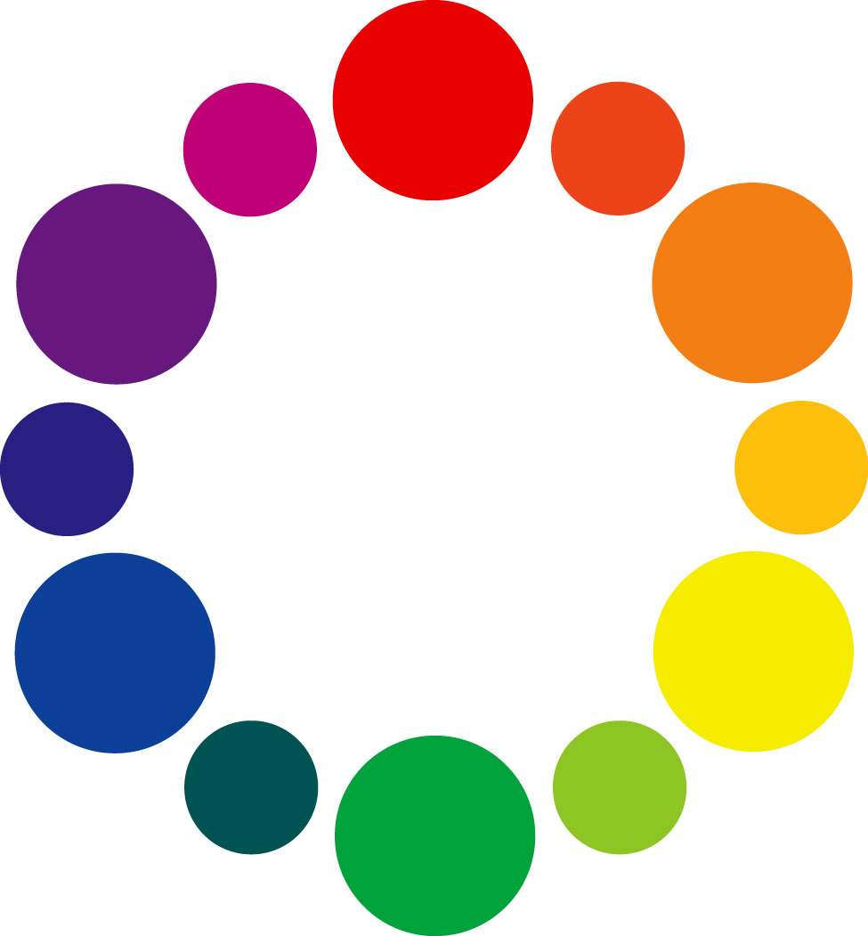
Elements of Composition
Line
Color
Hue
Value
Intensity
Shape/Form
Space
Texture
Primary
Secondary
Color
Wheel
Warm
Cool
Value
Intensity/Saturation
Notes:
Color talked about in 3 ways…
Hue – what is is? Red, green, yellow?
Value – how light or dark
Intensity (saturation) – how bright or dull
differentiates and defines lines, shapes, forms, and space.
often cultural symbolism or references
what can red symbolize? What is the context?
Not just analyzing the colors individually but what combinations exist

Slide 11
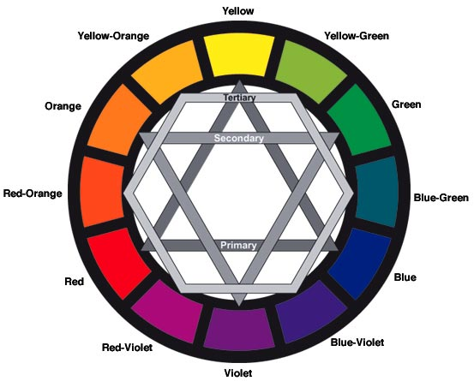
Primary Colors
The primary colors are red, blue, and yellow.
Primary colors cannot be made from other colors.

Slide 12
Secondary Colors
The secondary colors are orange, green, and purple.
Secondary colors are made from mixing the primary colors.

Slide 13
Hots and Colds

Slide 14
Warm Colors
The warm colors are red, orange, yellow, and anything in between.
They are called warm because they remind you of the sun or fire.
Warm colors seem to come out at you in space.
NEXT

Slide 15
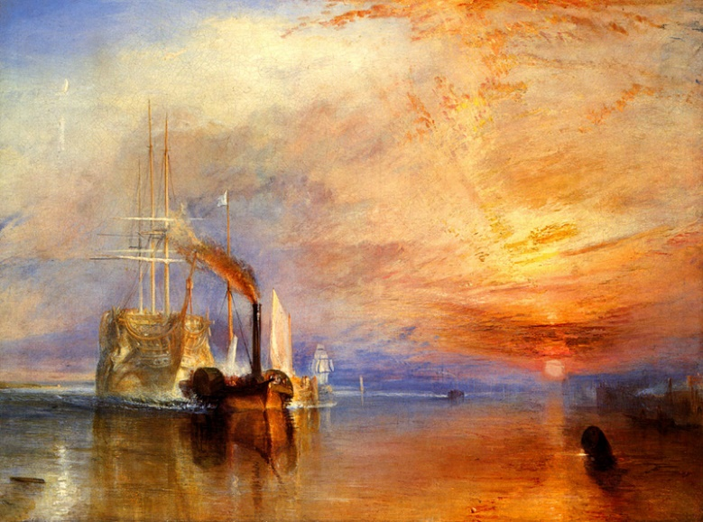
Warm Colors
In The Fighting Temeraire by William Turner, the warm colors of the sunset give a feeling of brightness and heat. Look at the red spreading from the setting sun and the deep golden glow on the water. If you're feeling cold, looking at colors like these can actually make you feel warmer!
The Fighting Temeraire by William Turner

Slide 16
Cool Colors
The Cool colors are blue, green, purple and anything in between.
They are called cool because they remind you of the earth or a cool creek.
Cool colors seem to recede from you in space.
NEXT

Slide 17
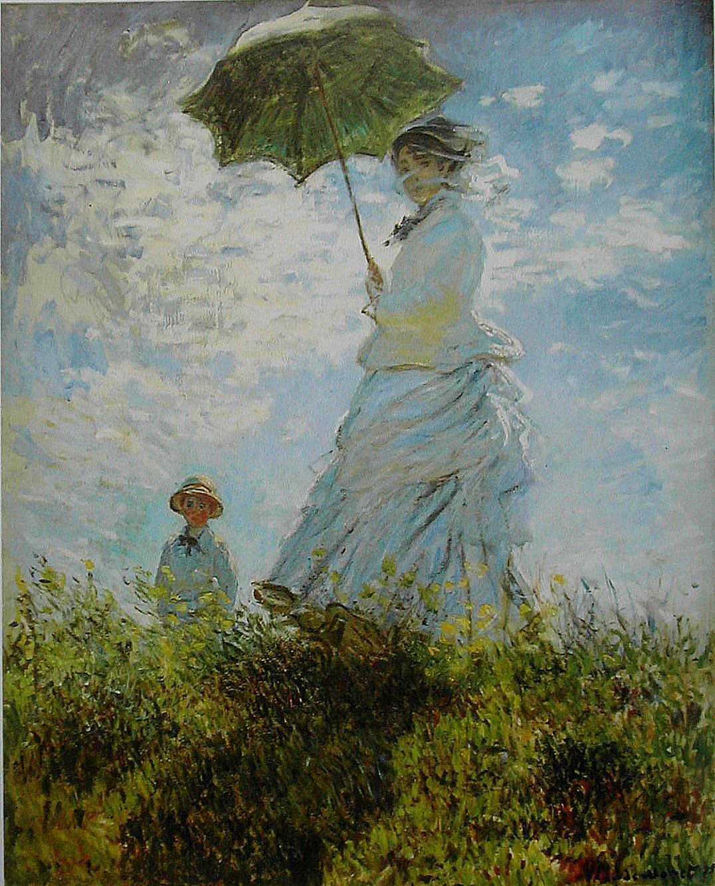
Cool Colors
In this painting by Claude Monet, The Walk, Lady with a Parasol , the cool colors of the ground and sky contributes to the peaceful feeling of the painting. Imagine how different the painting would look with a bright red sky—it might seem more exciting or energetic than restful.
The Walk, Lady with a Parasol by Claude Monet

Slide 18
Color
An element of art which has three properties.
1) Hue, which is the name of a color. For example, red, yellow, blue are hues.
2) Intensity, which refers to the brightness and purity of a color. For example, bright red or dull red.
3) Value, which refers to the lightness or darkness of a color.

Slide 19
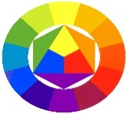
Hue
Return to Advanced Color Theory
Hue refers to the name of a color. For example red, blue, and purple are hues.
Return to Main Page

Slide 20
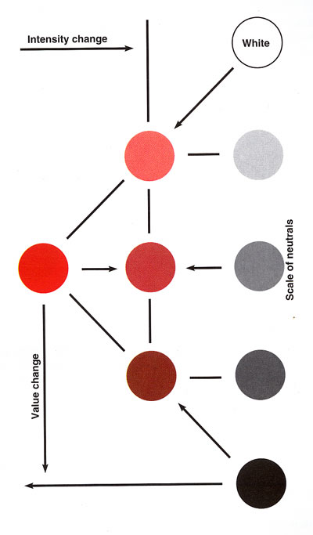
Intensity
Return to Advanced Color Theory
Intensity refers to the brightness or dullness of a color. An example is bright red (or dull red).
When a hue is strong and bright, it is said to be high in intensity. When a color is faint, dull and gray, it is said to be low in intensity.
Return to Main Page
Intensities of Green

Slide 21
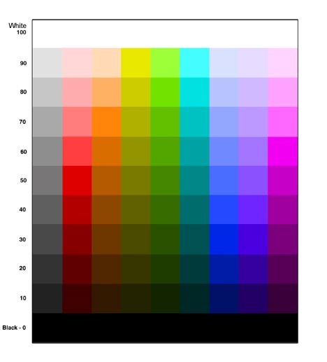
Value
Return to Advanced Color Theory
Here is an example of a value scale that has values ranging from the darkest dark, to the whitest white.
Value is the lightness or darkness of a color.
You can obtain different values by adding black or white to a color.
A light color is called a tint of the original hue. For example, pink is a tint of red.
To make a color darker in value, black is added. A dark color is called a shade of the original hue. Maroon is a shade of red.
Return to Main Page

Slide 23
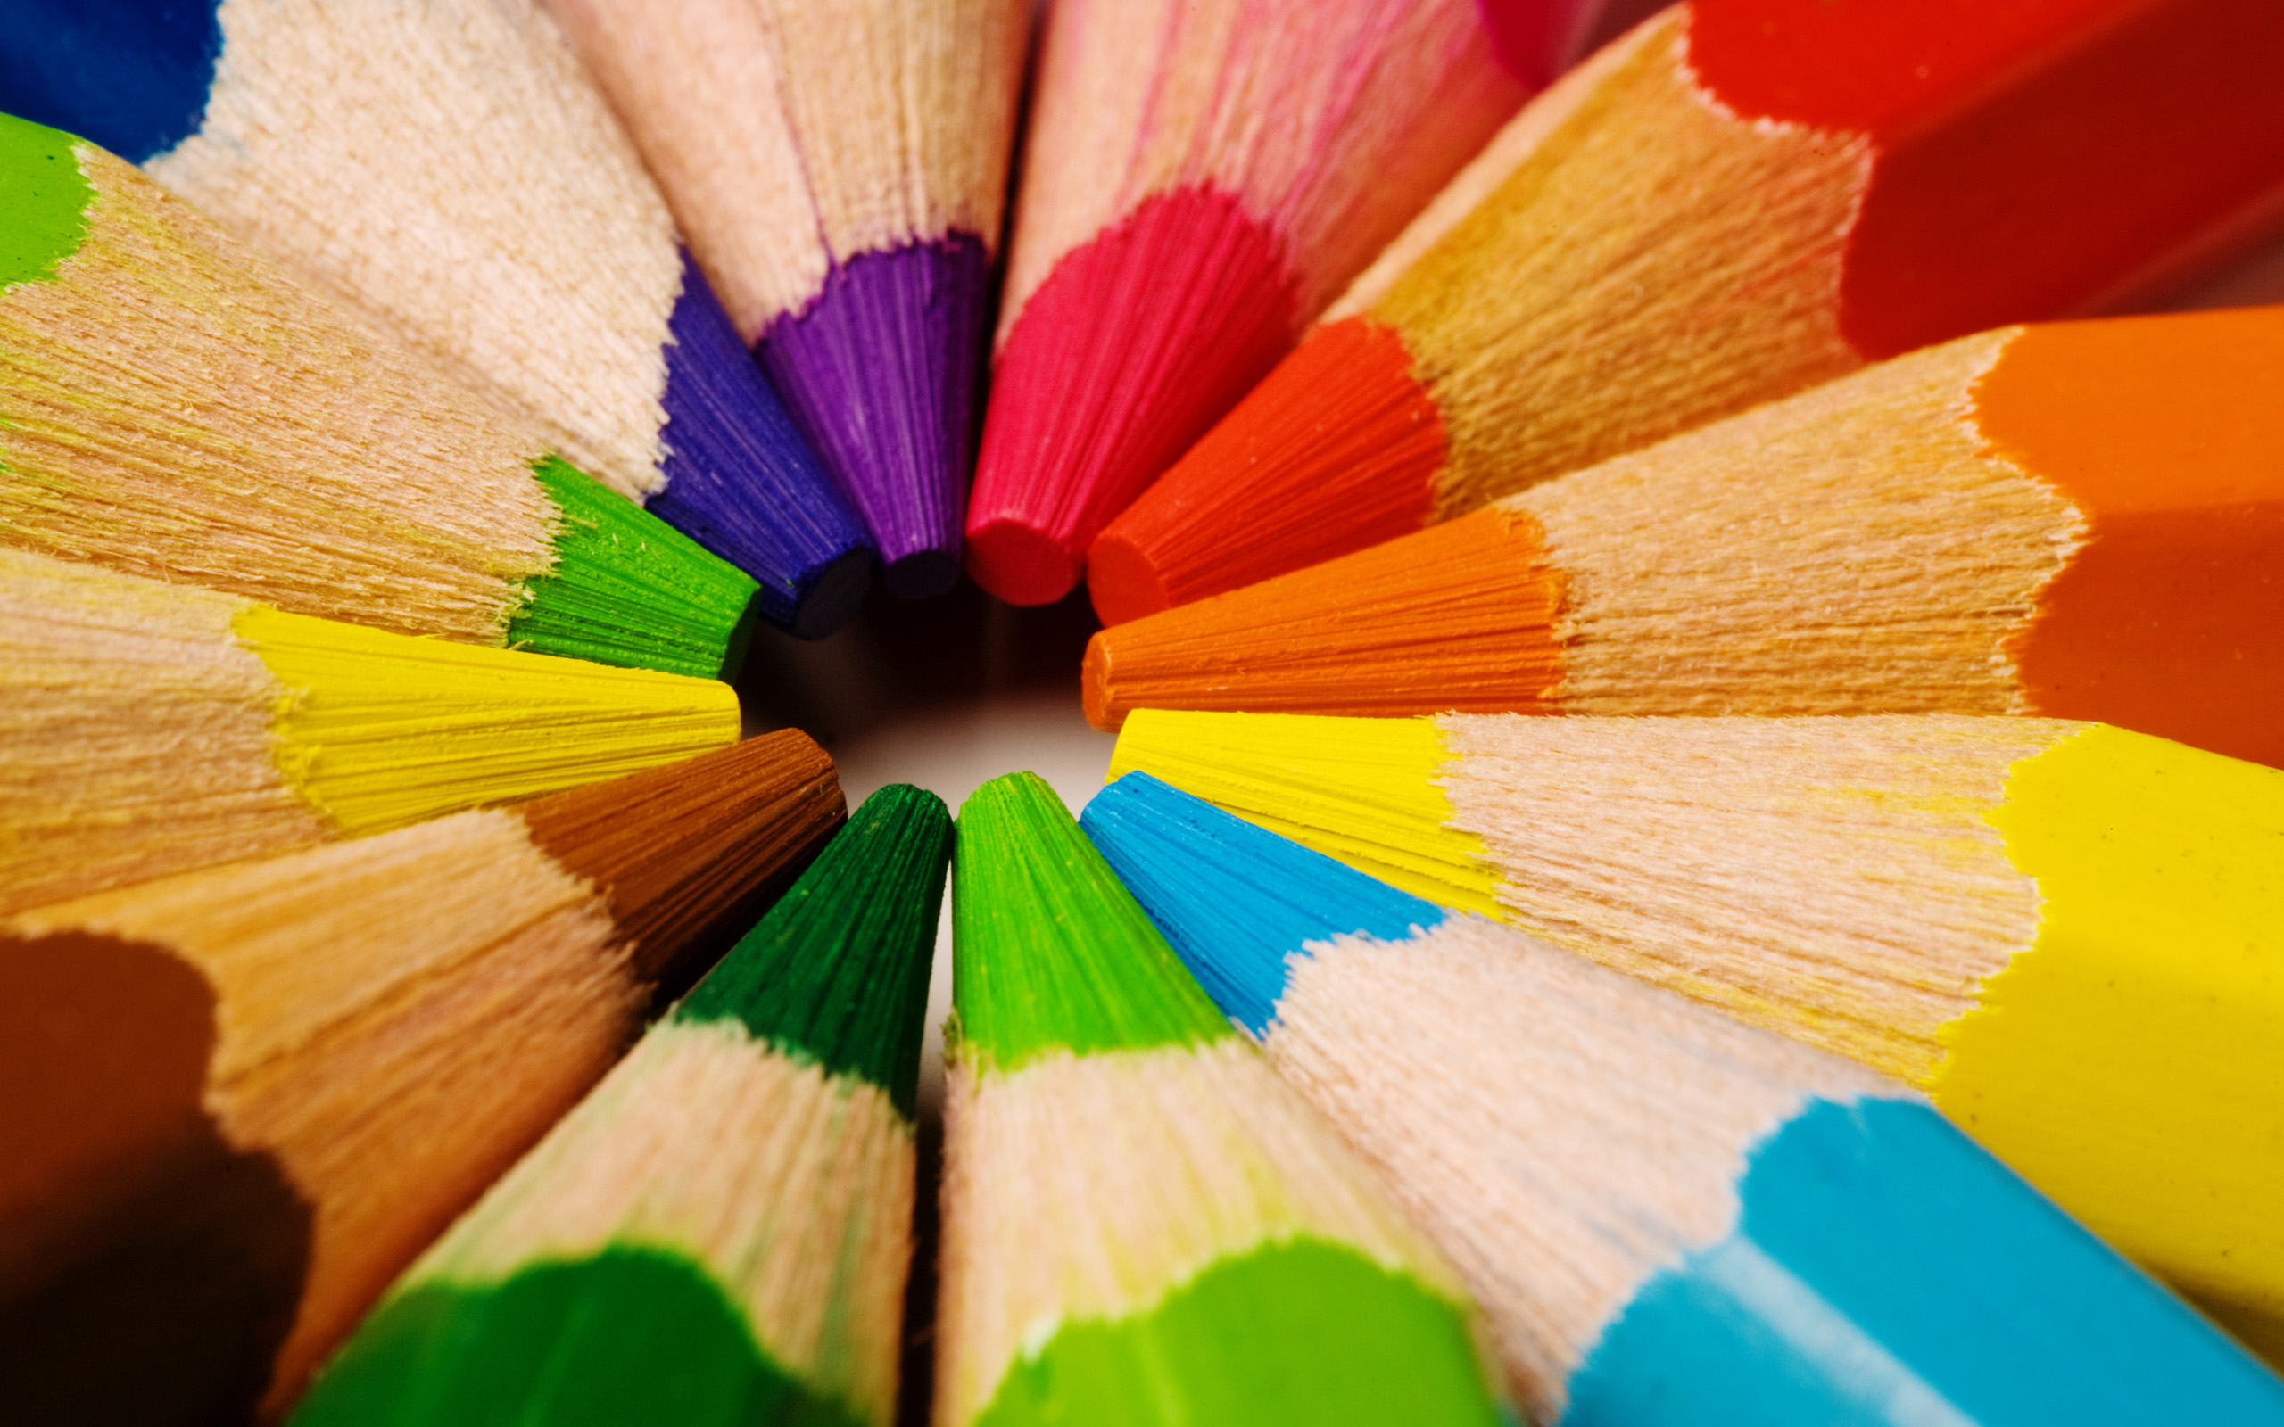
Meaning of Color
Color’s meaning is influenced by:
Culture
Age
Personality
Adjoining Colors
Individual Mood
The meaning of color!

Slide 24
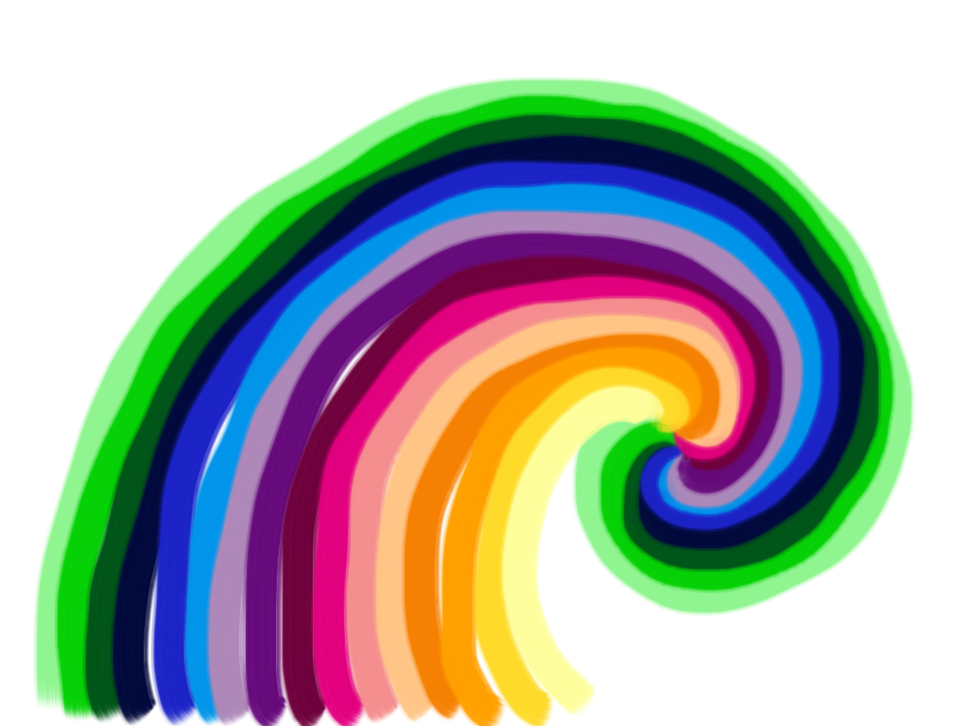
What does color communicate?

Slide 25
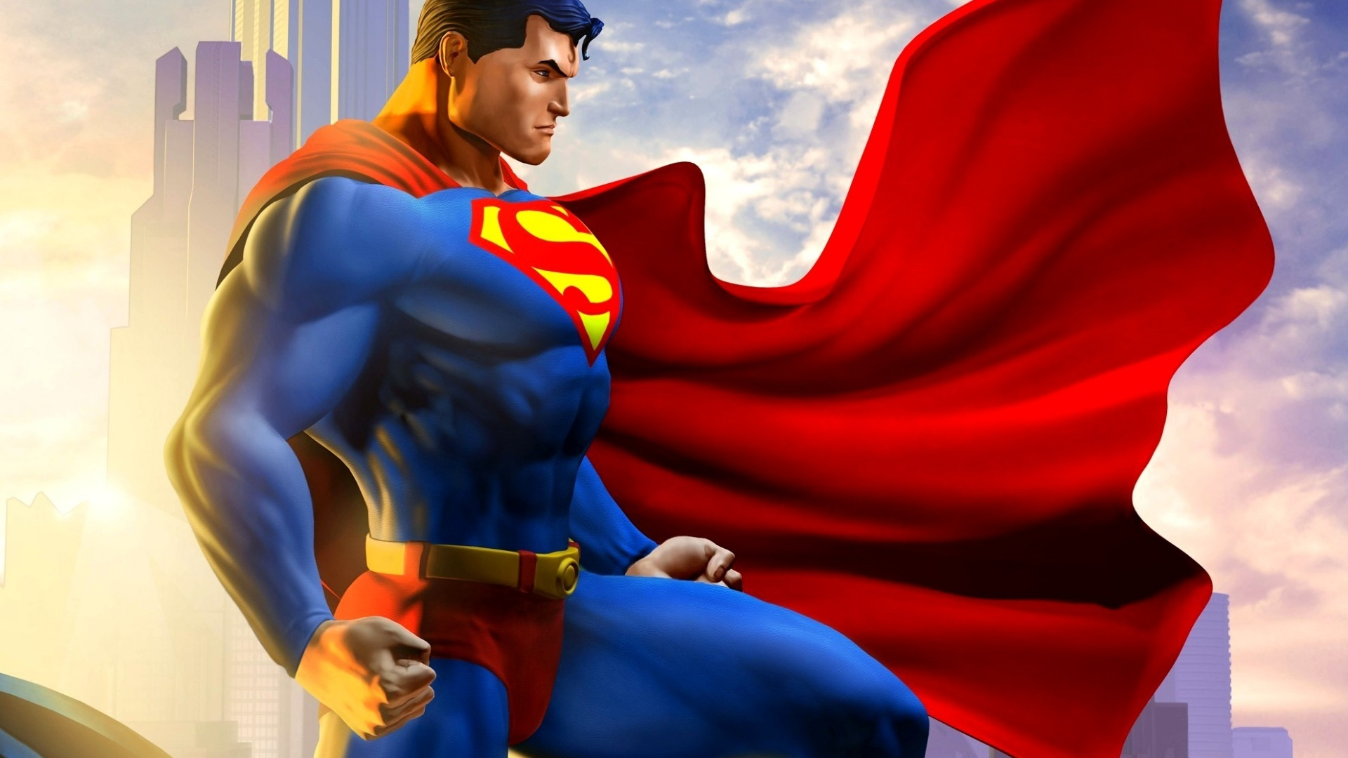
RED
Provocative
Affectionate
Striking
Active
Intense
Defiant
Powerful
Masterful
Strong
Hostile

Slide 26
The Meaning of Color-Red
Red is the color of fire. It is associated with energy, war, danger, strength, power, determination and love.
Red is a very emotionally intense color. It enhances human metabolism, increases respiration rate, and raises blood pressure. It has very high visibility, which is why stop signs, stoplights, and fire equipment are usually painted red. It is a color found in many national flags.
Red brings text and images to the foreground. Use it as an accent color to stimulate people to make quick decisions; it is a perfect color for 'Buy Now' or 'Click Here' buttons on Internet banners and websites. Red is widely used to indicate danger (high voltage signs, traffic lights).
Return to
Meaning of Color
Main Page

Slide 27
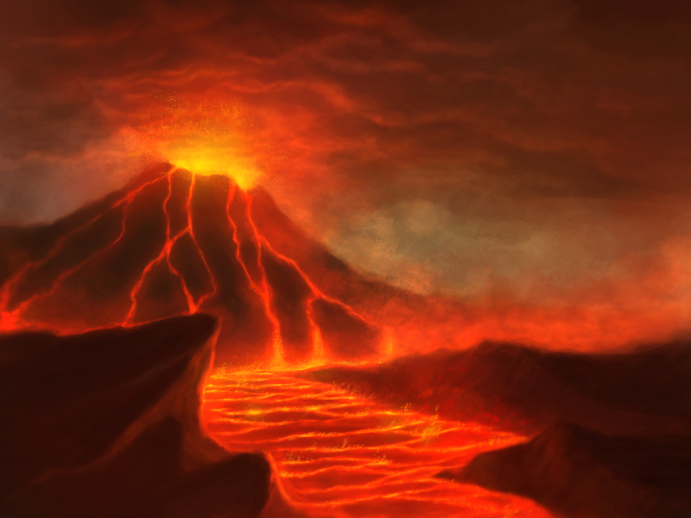
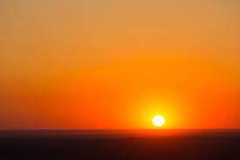
Orange
Warm
Happy
Exciting
Hot
Disturbed
Distressed
Unpleasant

Slide 28
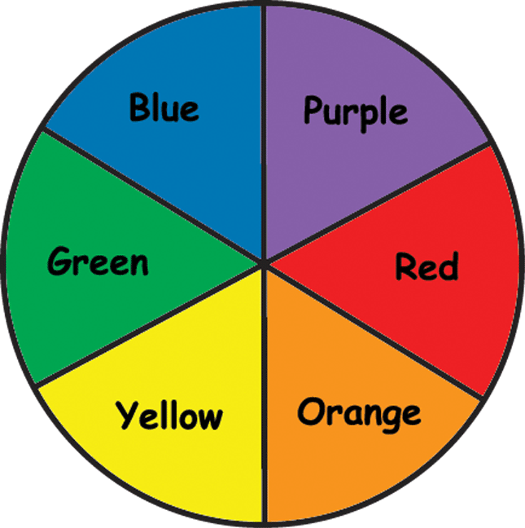
The Meaning of Color-Orange
Orange combines the energy of red and the happiness of yellow. It is associated with joy, sunshine, and the tropics. Orange represents enthusiasm, fascination, happiness, creativity, determination, attraction, success, and encouragement.
To the human eye, orange is a very hot color, so it gives the sensation of heat. Nevertheless, orange is not as aggressive as red. Orange increases oxygen supply to the brain, produces an invigorating effect, and stimulates mental activity. As a citrus color, orange is associated with healthy food and stimulates appetite. Orange is the color of fall and harvest.
Orange has very high visibility, so you can use it to catch attention and highlight the most important elements of your design.
Return to
Meaning of Color
Main Page

Slide 29
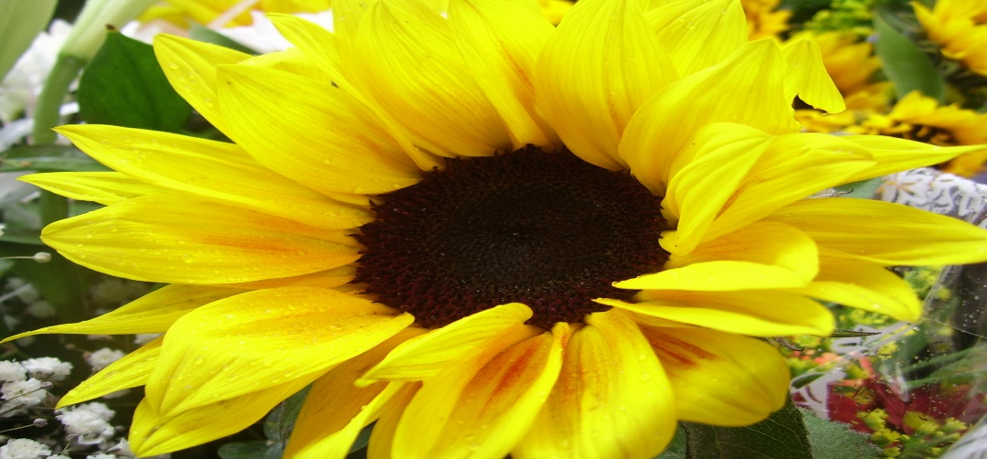
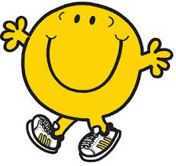
Yellow
Stimulating
Cheerful
Exciting
Joy
Serene
Unpleasant
Aggressive
Hostile

Slide 30
The Meaning of Color-Yellow
Yellow is the color of sunshine. It's associated with joy, happiness, intellect, and energy.
Yellow produces a warming effect, arouses cheerfulness, stimulates mental activity, and generates muscle energy. Yellow is often associated with food. Bright, pure yellow is an attention getter, which is the reason taxicabs are painted this color. When overused, yellow may have a disturbing effect; it is known that babies cry more in yellow rooms. Yellow is seen before other colors when placed against black; this combination is often used to issue a warning.
Use yellow to evoke pleasant, cheerful feelings. Yellow is very effective for attracting attention, so use it to highlight the most important elements of your design. Shades of yellow are visually unappealing because they loose cheerfulness and become dingy.
Return to
Meaning of Color
Main Page

Slide 31
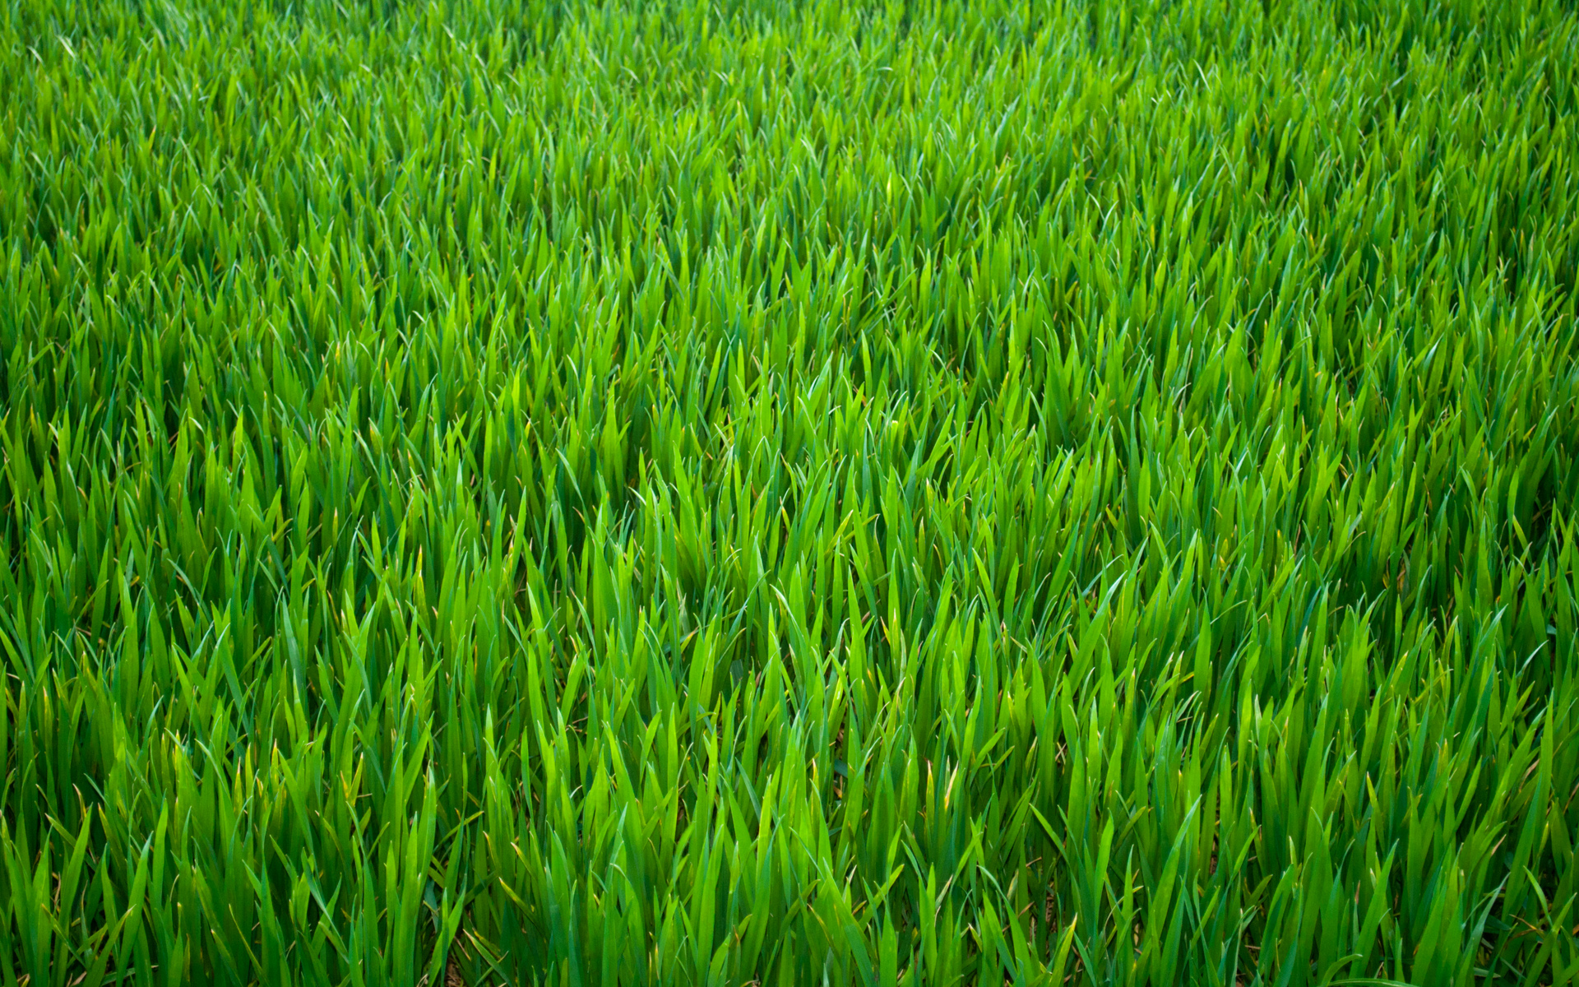
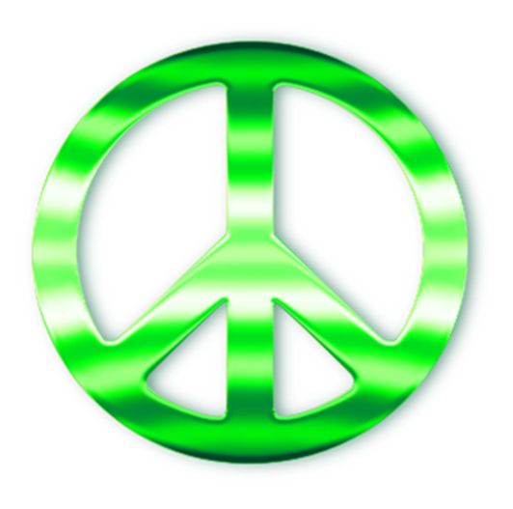
Green
Youthful
Fresh
Leisurely
Secure
Calm
Ill
Peaceful

Slide 32
The Meaning of Color-Green
Green is the color of nature. It symbolizes growth, harmony, and freshness. Green has strong emotional correspondence with safety. Dark green is also commonly associated with money.
Green has great healing power. It is the most restful color for the human eye; it can improve vision. Green suggests stability and endurance. Sometimes green denotes lack of experience; for example, a 'greenhorn' is a novice. Green, as opposed to red, means safety; it is the color of free passage in road traffic.
Green is directly related to nature, so you can use it to promote 'green' products. Dull, darker green is commonly associated with money, the financial world, banking, and Wall Street.
Dark green is associated with ambition, greed, and jealousy. Olive green is the traditional color of peace.
Return to
Meaning of Color
Main Page

Slide 33
Blue
Pleasant
Cool
Comfortable
Tender
Social
Dignified
Sad
Strong
Great
Full

Slide 34
The Meaning of Color-Blue
Blue is the color of the sky and sea. It symbolizes trust, loyalty, wisdom, confidence, intelligence, and truth.
Blue is considered beneficial to the mind and body. It slows human metabolism and produces a calming effect. Blue is strongly associated with tranquility and calmness.
Blue is used to promote products and services related to cleanliness (water purification filters, cleaning liquids), air and sky (airlines, airports, air conditioners), water and sea (sea voyages, mineral water).
When used together with warm colors like yellow or red, blue can create high-impact, vibrant designs; for example, blue-yellow-red is a perfect color scheme for a superhero.
Return to
Meaning of Color
Main Page

Slide 35
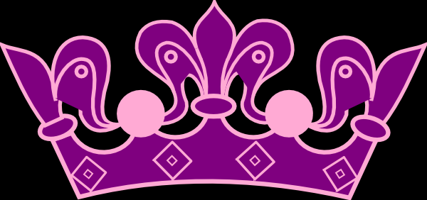
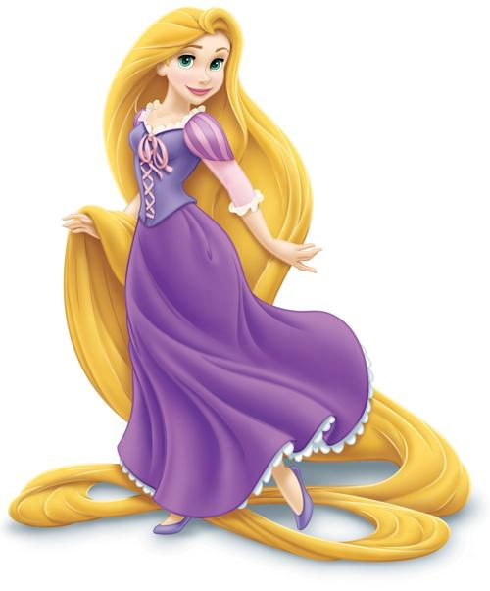
Purple
Dignified
Stately
Vigorous
Disagreeable
Sad
Dependent
Melancholy
Depressing

Slide 36
The Meaning of Color-Purple
Purple combines the stability of blue and the energy of red. Purple is associated with royalty. It symbolizes power, nobility, luxury, and ambition. It conveys wealth and extravagance. Purple is associated with wisdom, dignity, independence, creativity, mystery, and magic.
According to surveys, almost 75 percent of pre-adolescent children prefer purple to all other colors. Purple is a very rare color in nature; some people consider it to be artificial.
Return to
Meaning of Color
Main Page

Slide 37
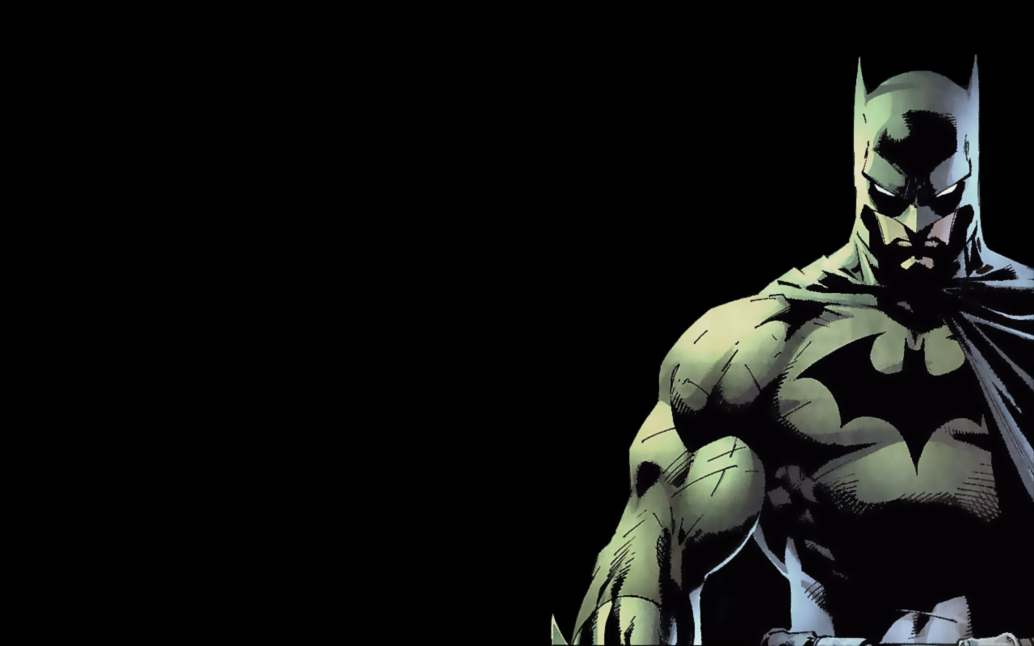
Black
Powerful
Modernity
Formality
Unhappy
Dignified
Strong
Powerful
Hostile
Distressed
Old

Slide 38
The Meaning of Color-Black
Black is associated with power, elegance, death, evil, and mystery.
Black is a mysterious color associated with fear and the unknown (black holes). Black denotes strength and authority; it is considered to be a very formal, elegant, and prestigious color (black tie event).
Black gives the feeling of perspective and depth. When designing for a gallery of art or photography, you can use a black or gray background to make the other colors stand out. Black contrasts well with bright colors. Combined with red or orange – other very powerful colors – black gives a very aggressive color scheme.
Return to
Meaning of Color
Main Page

Slide 39
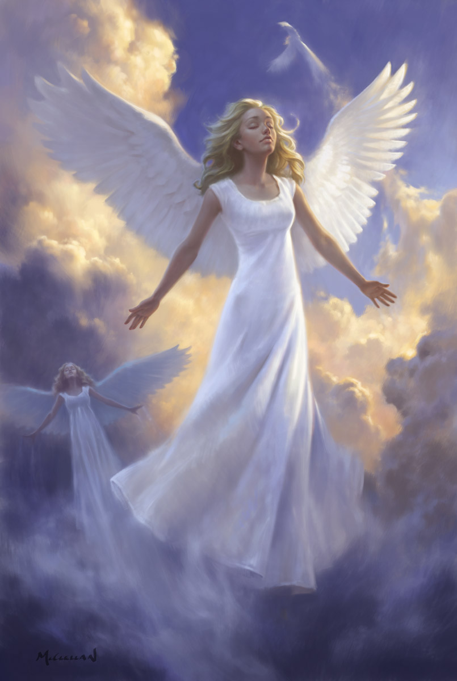
White
Pure
Tender
Soothing
Solemn
Empty

Slide 40
The Meaning of Color-White
White is associated with light, goodness, and innocence. It is considered to be the color of perfection.
White means safety, purity, and cleanliness. As opposed to black, white usually has a positive connotation. White can represent a successful beginning.
White is associated with hospitals, doctors, and sterility. White is also often associated with low weight, low-fat food, and dairy products.
Return to
Meaning of Color
Main Page

Slide 41
Go to Value
COLOR MIXING Value, Tints, & Shades
The lightness or darkness of a color is called its value.
Tints are light values that are made by mixing a color with white.
For example, pink is a tint of red (red+white), and gray is a tint of black (black+white).
Shades are dark values that are made by mixing a color with black.
Maroon is a shade of red, and navy is a shade of blue.

Slide 42
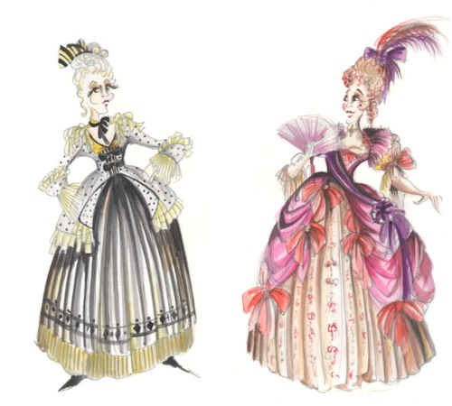
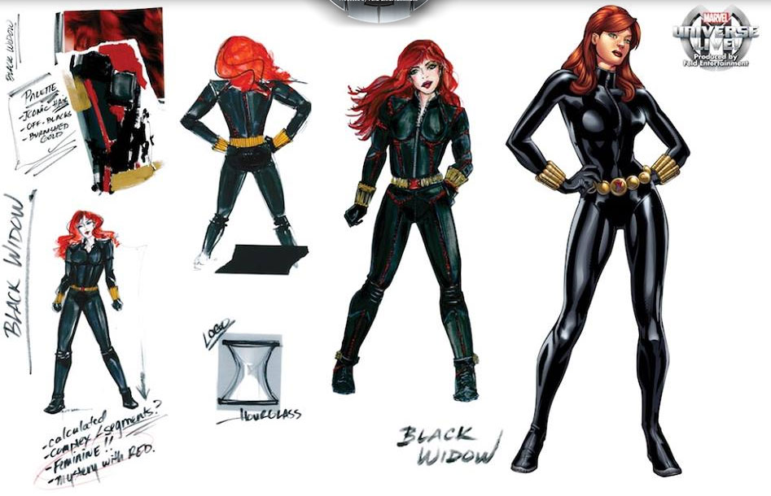

Slide 43
Brown
Secure
Comfortable
Full
Sad
Disagreeable

Slide 44
Other Things to Consider in Your Design
What type of Fabrics will it be made of?
Natural: Cotton, Linen, Silk, Wool
Synthetic: Acrylic, Nylon, Polyester, Rayon
The Type of Fabric will determine the texture of your costume- and texture communicates meaning.
Consider the difference between a character wearing linen or wearing silk?

Slide 45
What angles and lines will be used in your design?
Consider the difference between stiff lines and soft curves.
What kind of shapes can you use in your design? Geometric/Natural?
Will you be able to see the human form beneath the costume?

Slide 46
Color, texture and lines can say a lot for you!
Consider these different combinations:
Brown, rough cotton in soft lines.
Orange, slick polyester, with sharp angles.
Blue sheer fabric with a floating silhouette.
White wool with an unnatural shape.
Any others you can think of…
When creating a costume be aware of what the choices you make are communicating to others.

